Slide 1
PikeVM Rocqs!
Marcin Wojnarowski

Slide 2
Regular expressions (regexes)

Slide 3
Classical regular expressions
Studied for decades
Believed to be well understood
Mechanized by master students as homework
Often interested in the question "does it match a string or not?"
r + s
r ∘ s
r∗
c
ε

Slide 4
Modern regular expressions
Groups (mysubpattern)
Anchors ^ $ \b
Look-arounds (?<!dogs) are better
Backreferences Your name is (\w+)\? Hello \1!
Greedy vs lazy quantifiers
Different semantics for matching (for example leftmost -longest vs -first)
Often interested in the question "does it match a string, where, and what are the group values?"

Slide 5

Different semantics
Programing languages might implement regexes with their own quirky quirks.
As per your intuition, JavaScript has quirks in its regex semantics too!
We will follow the ECMAScript 2023 specification.

Slide 6
Regex engines: problem
Having a correct matching algorithm is not that hard, what is hard are the following:
Guaranteeing some complexity characteristic (linearity)
Being fast (many heuristics)
The growing complexity of these algorithms make the implementations prone to bugs and hard to reason about.

Slide 7
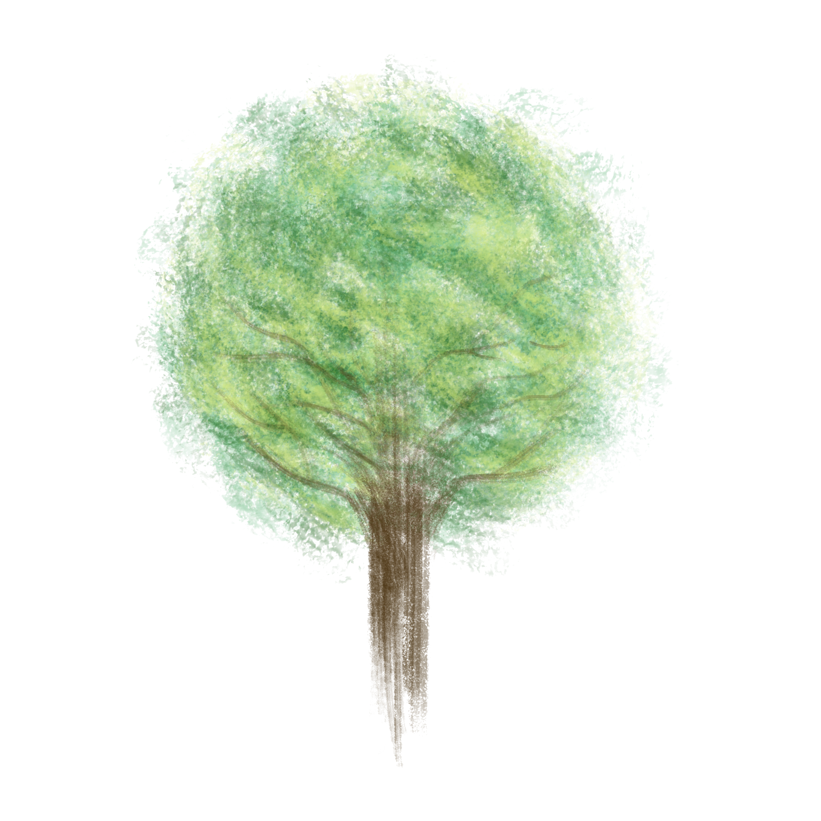
Linden
Mechanization of real-world regexes and their matching semantics
Proven to be faithful to the ECMAScript 2023 specification by means of Warblre
Mechanization of the PikeVM matching algorithm

Slide 8
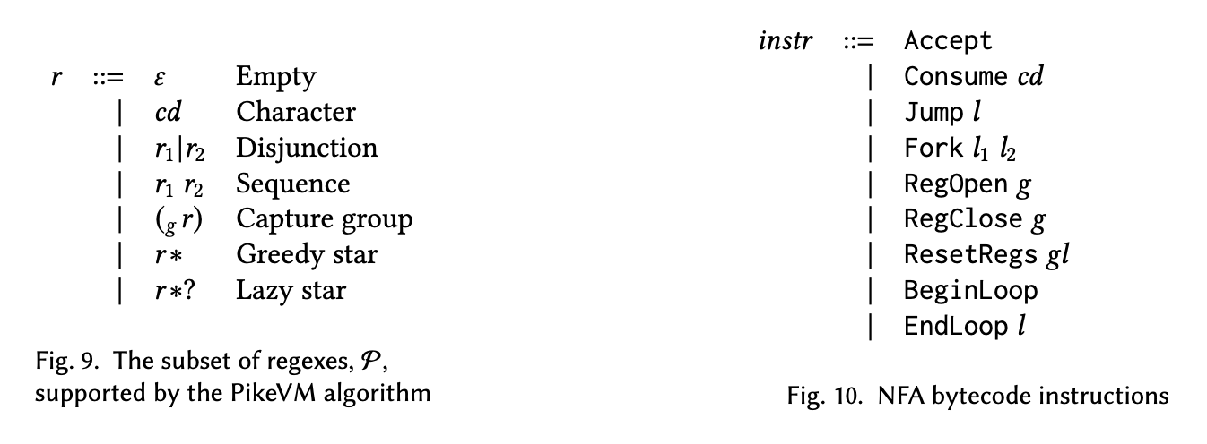
PikeVM (in Linden)

Slide 9
PikeVM (in Linden) : what is missing?
Regex features
Heuristics/optimizations
Anchors (^, $, \b, \B)
General quantifiers (r{10, 15})
Look-arounds (a(?=b))
Prefix acceleration
Bounded look-behind optimization

Slide 10
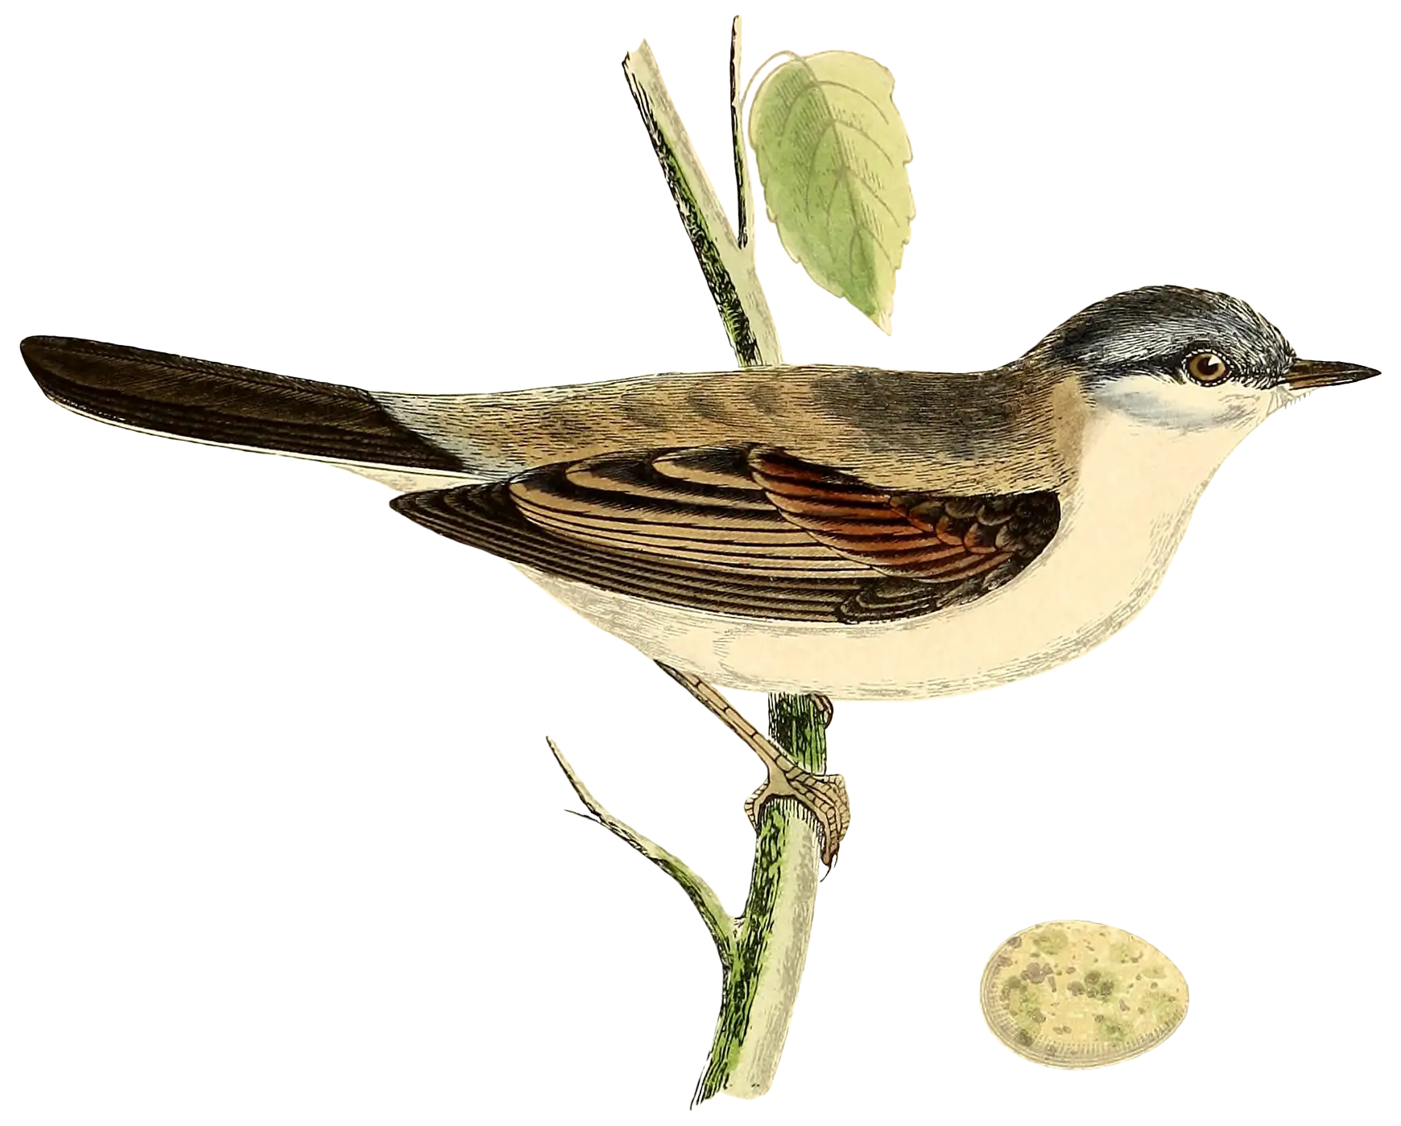
Goal
Enlarge the subset of regexes supported by the PikeVM formalization and prove correctness of real-world heuristics

Slide 11
Prefix acceleration
(abc|abcde)p*t
Literal prefix extraction => "abc"
Using a substring search, find next position in the haystack with that literal => "qwe|abckabcpppt"
Run the PikeVM at that position
If no match is found, go back to step 2 => "qweabck|abcpppt"
"qweabckabcpppt"

Slide 12
Le merci

